Slide 1
Chump Change
By Deepak Kasi Nathan and Hutoun Almutairi

Slide 2
Brief Introduction on our fictional company
Our project aims to build a website for a fintech company. We have decided to create a fictional company named Chump change , to which we are building a new website .
Our fictional company predominantly operates in these 4 domains listed below :
credit card signup bonus tracking ,
deals and rewards ,
account manager and
Chump change’s signature feature , "debt repayment service”.

Slide 3
How it Works ?
“Signup bonus Tracker” : credit cards offer huge signup bonuses worth hundreds of dollars to attract new customers , our platform will bring in a curated list of ongoing bonuses and it also provides tracker that tracks their progress on meeting minimum spend requirements
“Deals Magnet” : Another feature called Deals Magnet which is essentially a cheat sheet to maximize rewards earning , it will select their best deals available for users based on their cards and their locations which means users will never miss out on their deals
“Account Manager” : This will enable users to see all their account balances , reward balances , rewards earnings , debt balance , credit utilization and their credit scores .

Slide 4
How it Works ?
“Debt Repayment Service ” : This feature ties all our clients service to bring a new positive standard for debt repayment. Consider following example , If a user spends 48 dollars on groceries through our client’s payment method, our client will roundup this purchase to 50 dollars and put remaining 2 dollars towards debt repayment such that these roundups for each natural everyday purchase a user makes , it will slowly eat away user’s debt without even them noticing it . We also have a debt tracker that will track user’s debt and will let users know when they will be debt-free based on their spending habits .

Slide 5
Target Demographic
Our client primarily expect college students to be their users , people of age between 21 to 34 would be their target audience but anyone with student debt who likes to get back some extra cash can benefit from our client service. Even though our target demographic is 21-24 , we expect to see significant traffic from people of age 34 to 49 as well . Our client expects college students of all ethnicity , gender and country to make use of their product features .

Slide 6
And That’s our summary on our project Idea

Slide 7
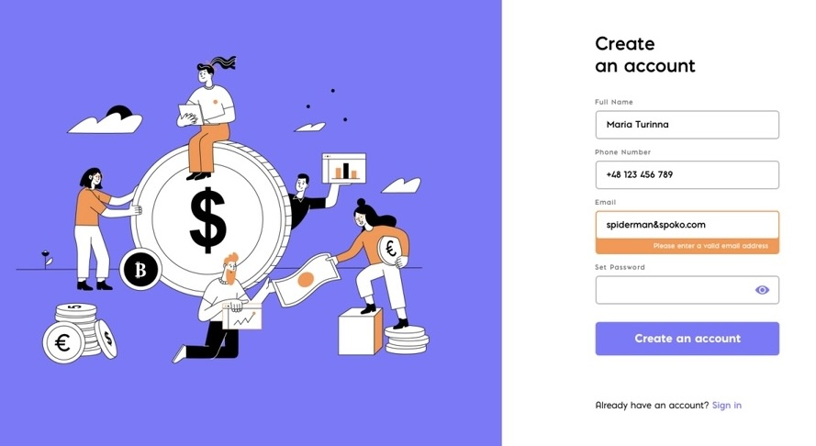
A complete list of all the pages and functionalities of the site : USER
Let's Start from Basics : Getting to know the user
Like all websites , we have a signup page that collects users' basics info and in addition , we also require users to connect their credit card account , debt account and checking account info while signing up .

Slide 8
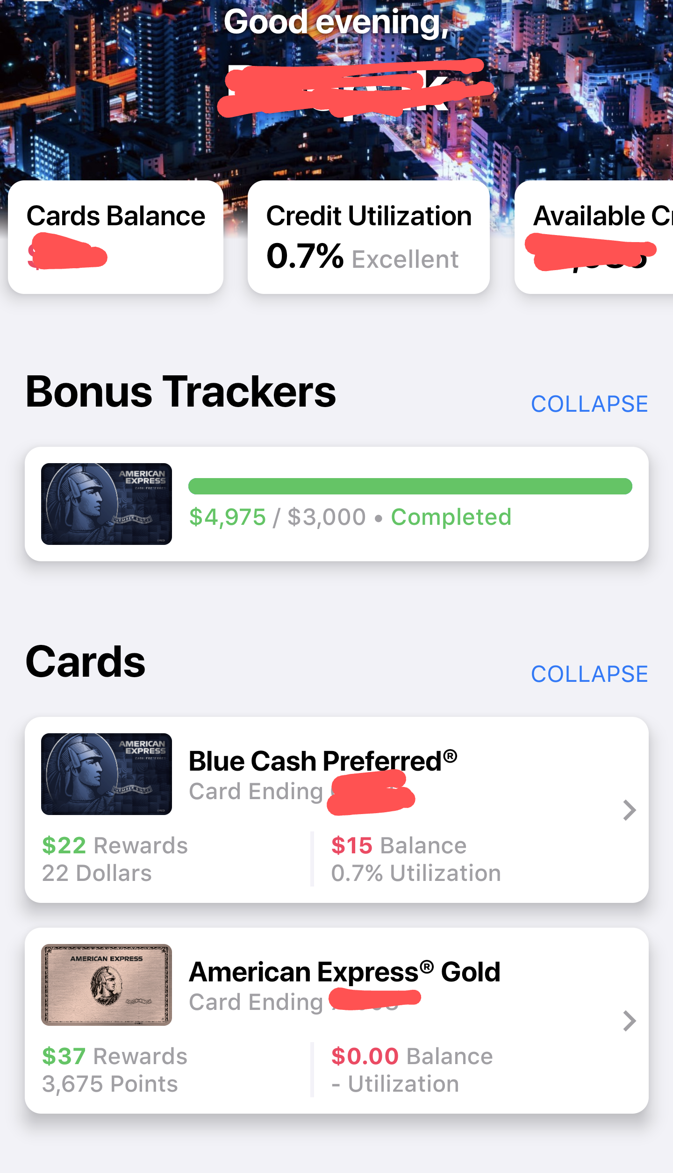
A complete list of all the pages and functionalities of the site : USER
Our first part of website : signup bonus Tracker
We have planned to show all credit cards and their respective bonus trackers on first section of our website , we also show other general information such as card balance , utilization on this page as well .

Slide 9
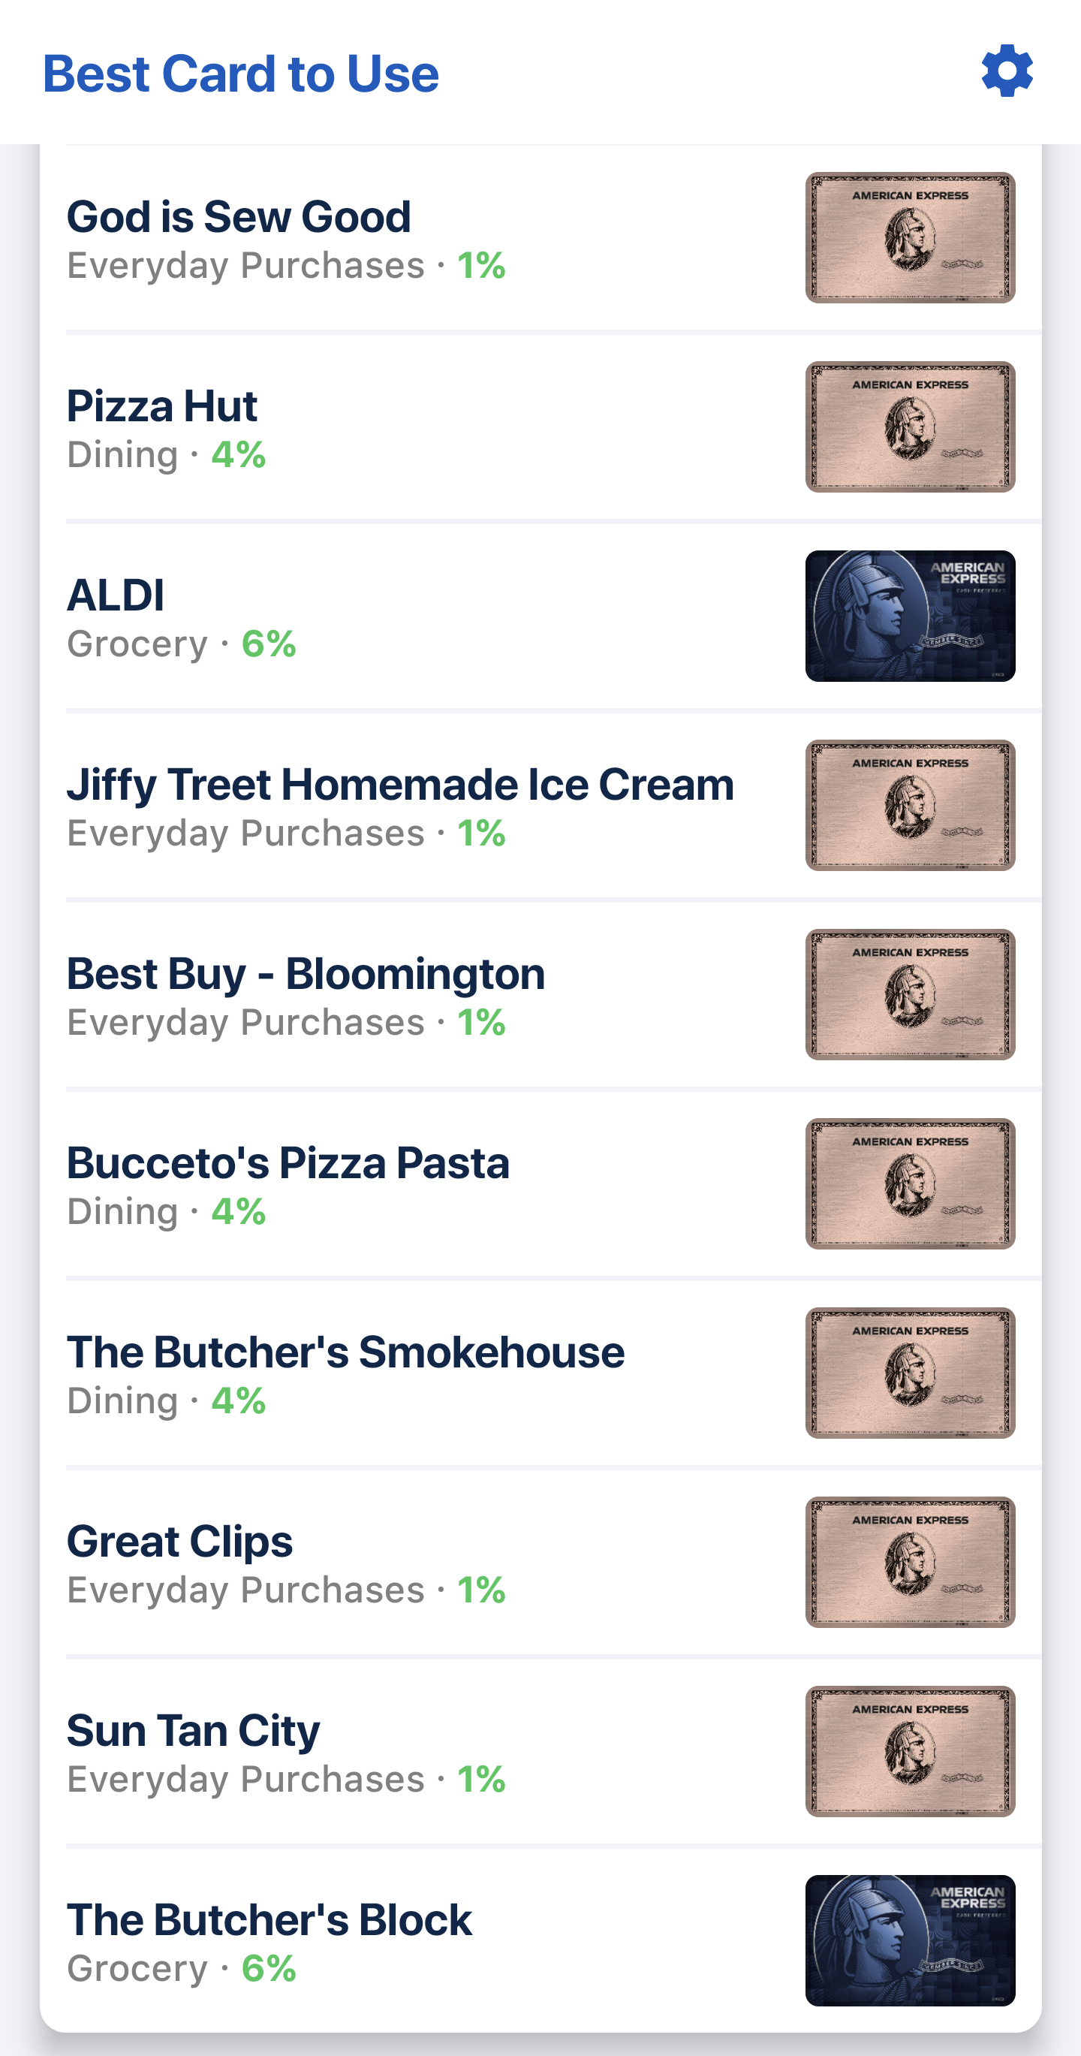
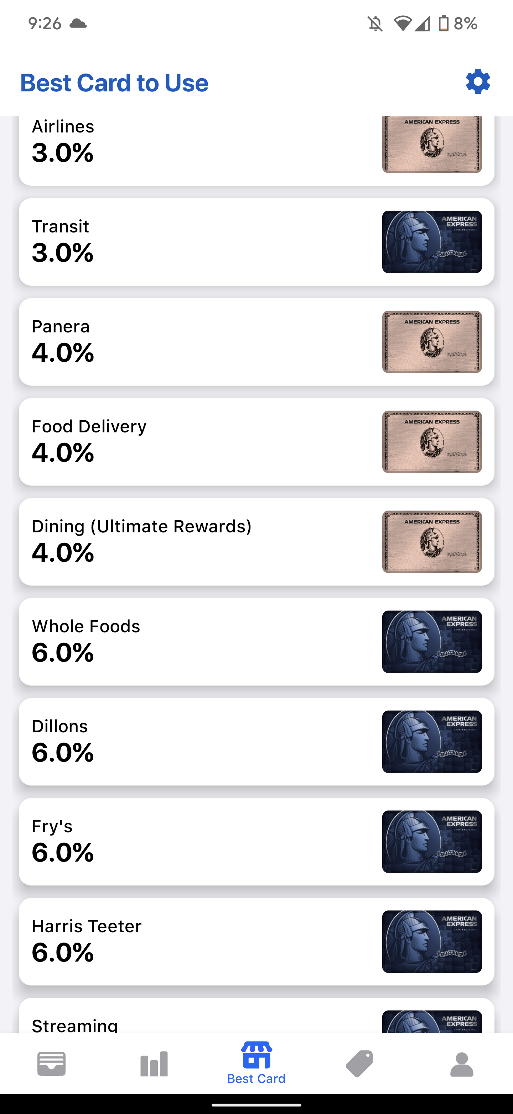
A complete list of all the pages and functionalities of the site : USER
Second part of website : Deals and rewards
As we have explained earlier , we will provide best deals or rewards that’s available for our users based on their locations and categories.
Offers based on location
Offers based on Categories

Slide 10
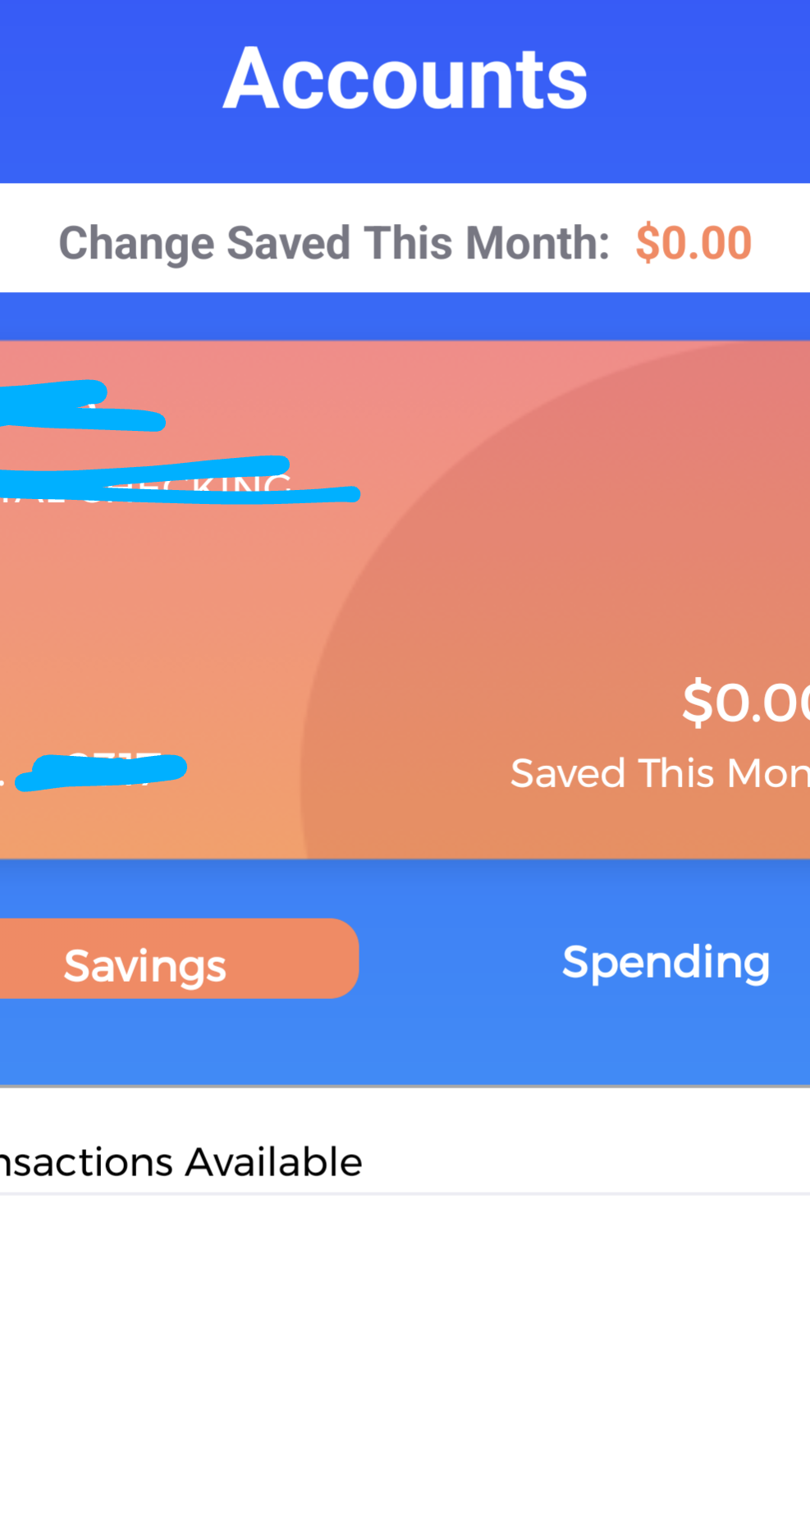
A complete list of all the pages and functionalities of the site : USER
Third part of website : Account Manager
Accounts manager will have features to monitor user’s transactions , their savings and their profile information.

Slide 11
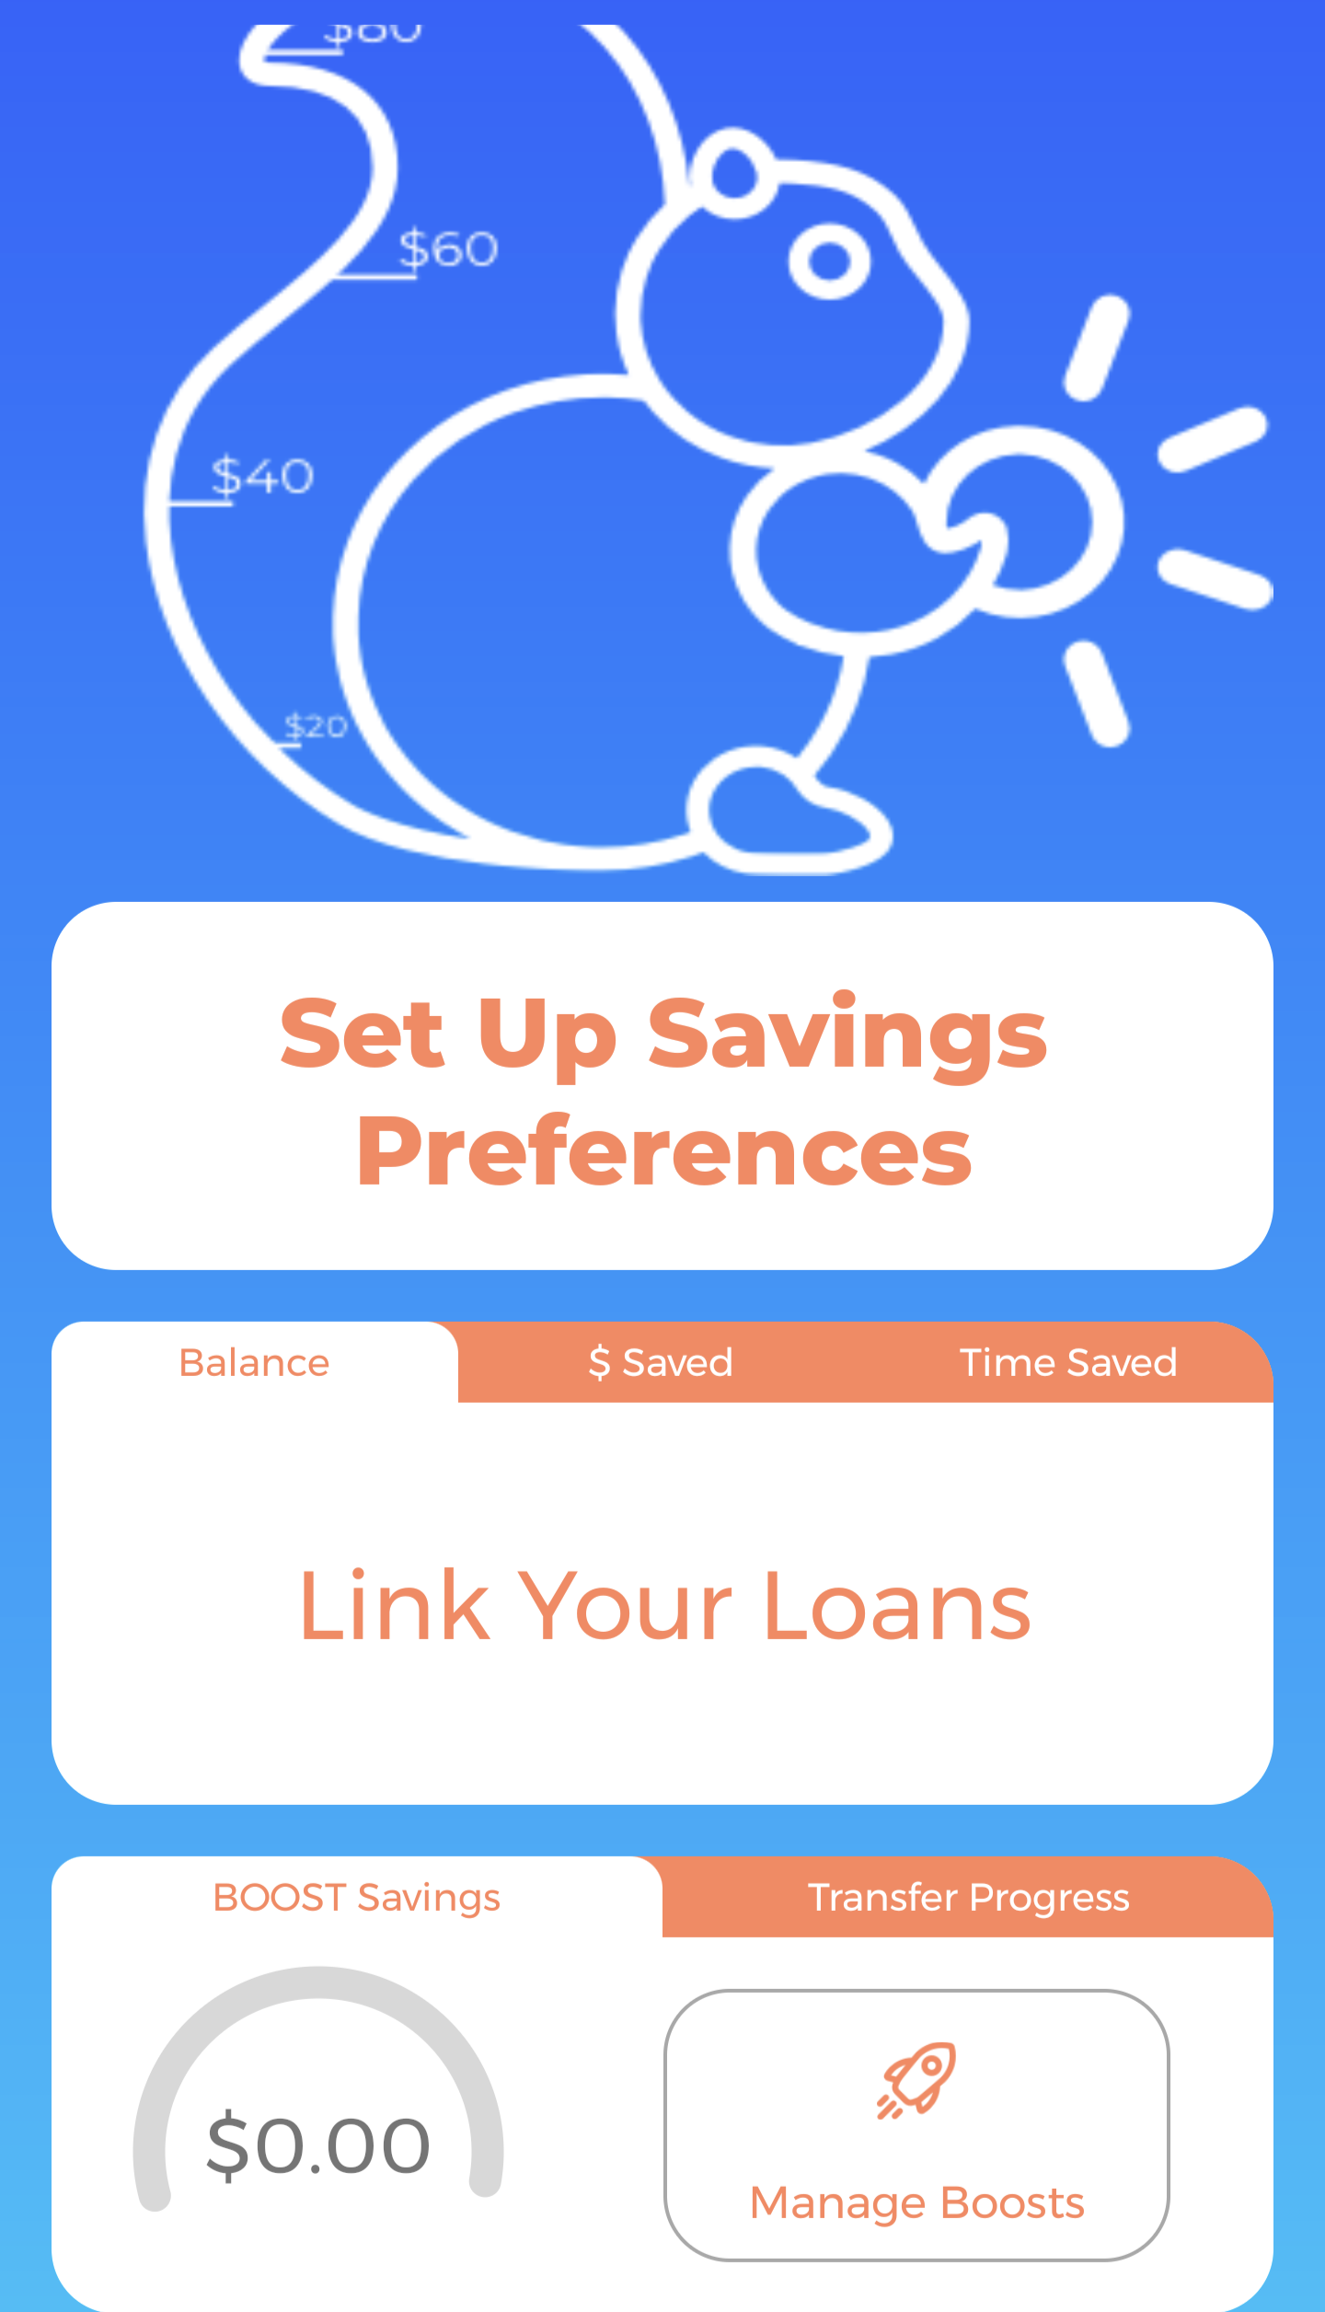
A complete list of all the pages and functionalities of the site : USER
Last part of website : Debt Payment Service
In this part of service , we will have user’s linked accounts , saved money details , saved time details and debt tracker etc.,
Idea of our site’s feature

Slide 12
A complete list of all the pages and functionalities of the site : General
General Site Pages
Apart from these pages we have shown before , our site will have general pages like
Contact Page
About US page
Referral Page
What's new and Request A new feature Page
FAQ Page and
A customer Support page to help with users' troubles (help center )

Slide 13
A complete list of all the pages and functionalities of the site : USER vs Admins
Additional features of admin
Apart from all these features , admins will have access to change data where if in case there is any transaction details that needs to be changed but, in most cases, users will be only allowed to see transactions details .
Admins will be allowed to change profile information of users .
Admins will be allowed to take off or bring in new deals and rewards as per company's policies .
Admins will have access to post affiliate links and publish useful fintech articles .
Admins have privilege to close accounts on request behalf of their users
Support page to help users

Slide 14
The technologies used on the website
As far as technologies are concerned , we planning to implement our design using HTML with Bootstrap along with PHP & SQL to handle our backend . If any new technologies are added to our site , we will update it in our final presentation .

Slide 15
Breakdown of group member responsibilities
Roles and Responsibilities | Teammate
Brainstorming for Ideas | Both
Seed for this project | Deepak Kasi Nathan
Project Brief Report Draft 1 | Deepak Kasi Nathan
Project Brief Report Draft 2 | Hutoun Almutairi
Proof reading project brief | Both
Requirement analysis Draft | Deepak Kasi Nathan
Requirement analysis Proofreading | Hutoun Almutairi

Slide 16
Breakdown of group member responsibilities
Roles and Responsibilities | Teammate
Design selection of website | Both
Design and code of first and Last part of website | Deepak Kasi Nathan
Design and code of second and third part of website | Hutoun Almutairi
Design and code of Admin features | Both
Initial and final draft of this presentation | Deepak and Hutoun Respectively
Finalizing project technologies | Both

Slide 17
Thank You .

